Slide 1
L3AC Audio Tokenizer Fine Tuning for Guitar Effects
Josh Miao
ECE 471-1 Music Information Retrieval

Slide 2


Audio Tokenization
Computer like numbers
Audio to numbers how???
Vectorization & Quantization!!!

Slide 3
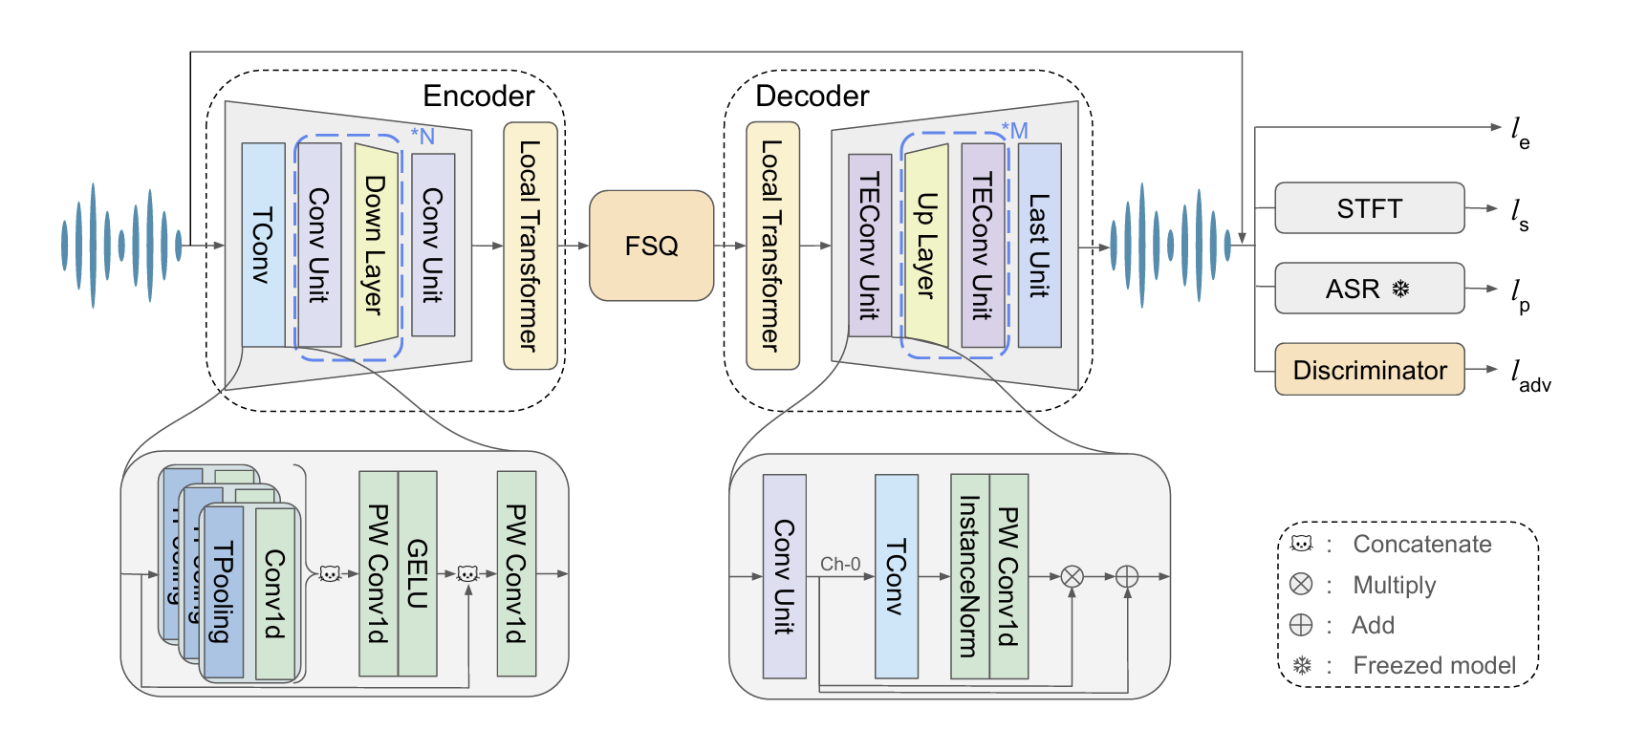
Lightweight & LossLess Audio Codec(L3AC)
Speech, Music, General Audio

Slide 4
L3AC Audio Tokenizer
Single Quantizer
Lighter
One mapping guarantees reversability
Transformer

Slide 5
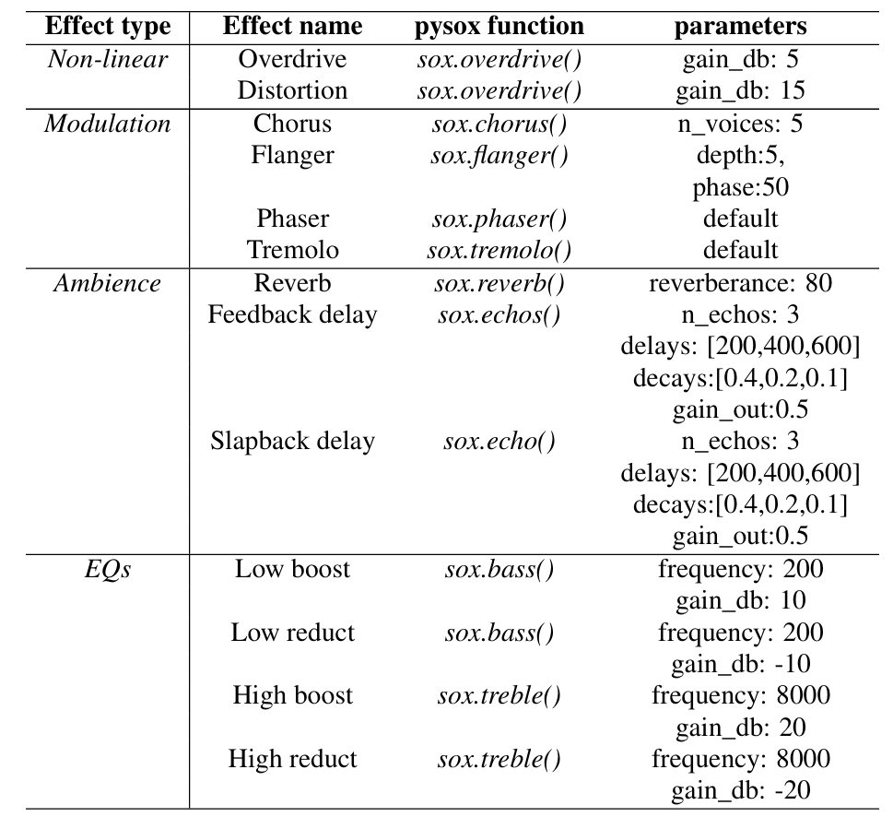
Audio Effects

Slide 6
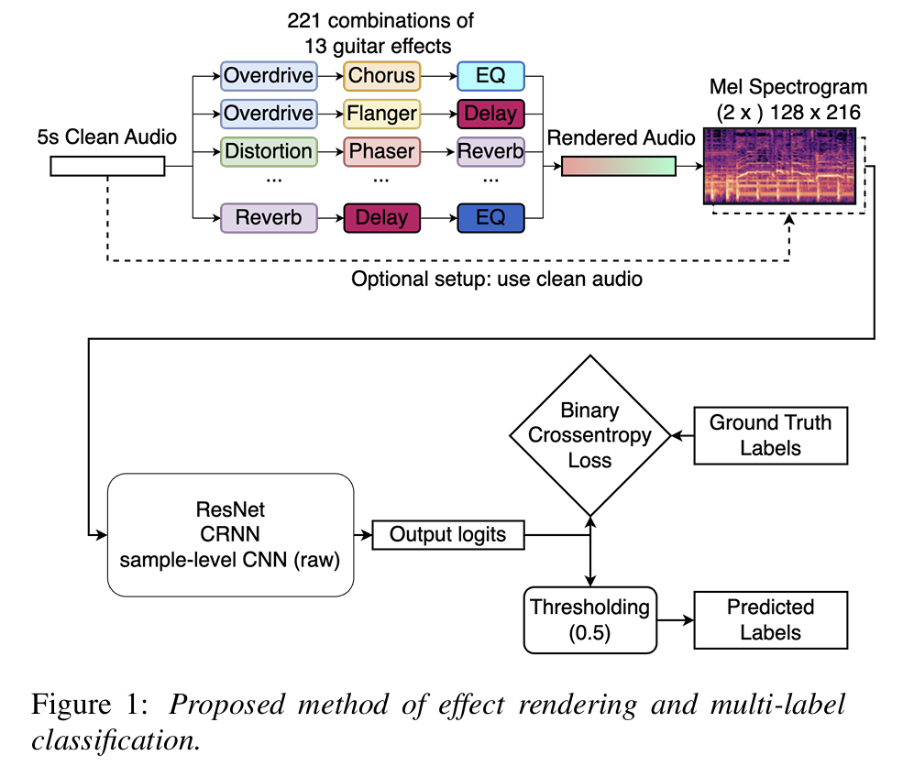


Classifier as Evaluation Metric
MLP

Slide 7
Fine Tuning
Pretrained models: .75, 1, 2, 3, kbps
Adopt for guitar audio with effects
Retrain on small dataset to learn nuances of domain
Early layers frozen(low-level features)
Later layers(task-specific) updated

Slide 8
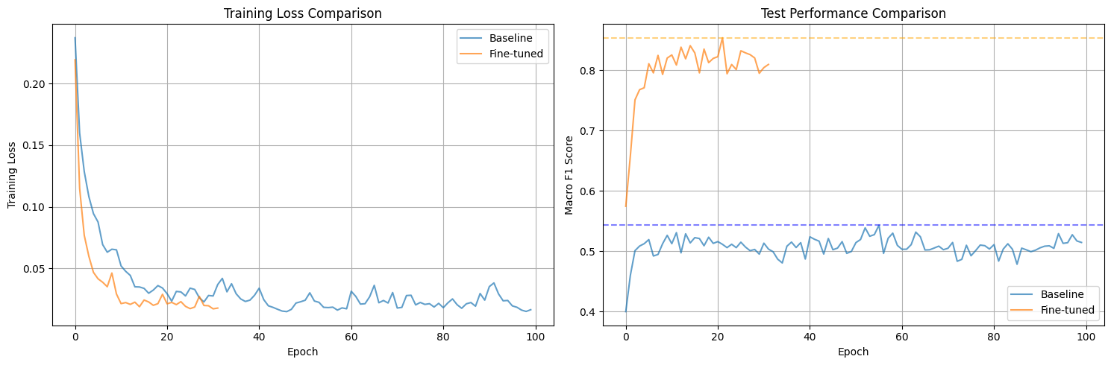
Results

Slide 9
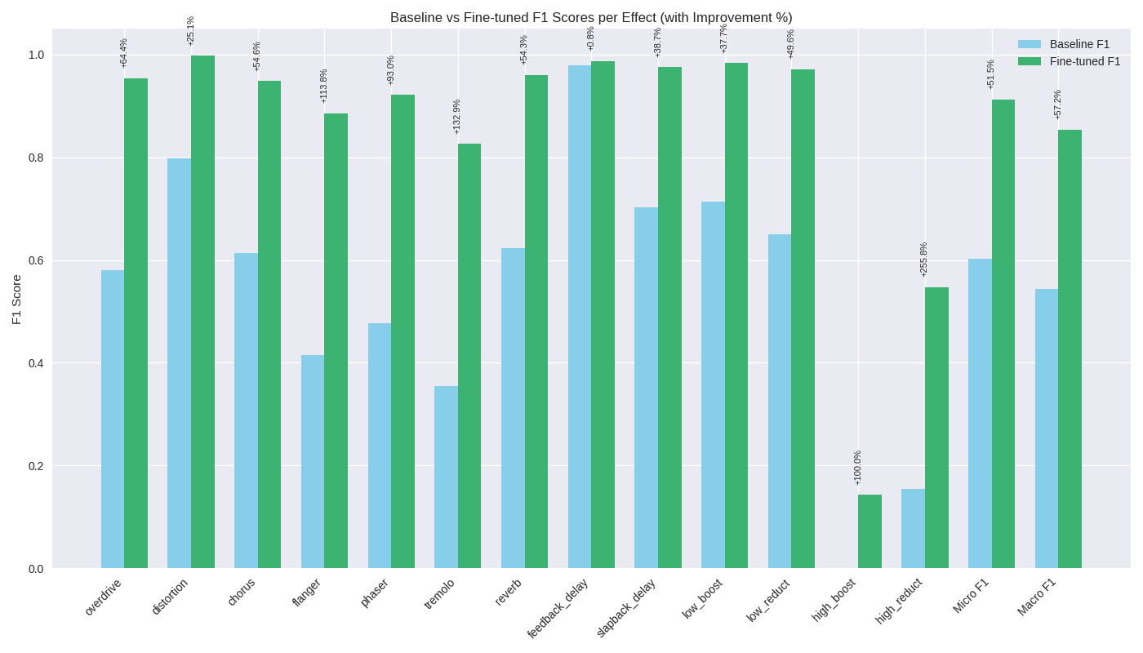
Results Cont.
Effect | Baseline F1 | Fine-tuned F1 | Improvement (%)
Micro F1 | 0.6025 | 0.9126 | +31.01
Macro F1 | 0.5431 | 0.8540 | +31.09
overdrive | 0.5802 | 0.9537 | +64.37
distortion | 0.7978 | 0.9977 | +25.06
chorus | 0.6134 | 0.9484 | +54.60
flanger | 0.4143 | 0.8857 | +113.76
phaser | 0.4775 | 0.9215 | +92.97
tremolo | 0.3548 | 0.8263 | +132.86
reverb | 0.6225 | 0.9607 | +54.33
feedback_delay | 0.9792 | 0.9873 | +0.83
slapback_delay | 0.7034 | 0.9756 | +38.69
low_boost | 0.7143 | 0.9836 | +37.70
low_reduct | 0.6494 | 0.9714 | +49.60
high_boost | 0.0000 | 0.1429 | +100.00
high_reduct | 0.1538 | 0.5474 | +255.79

Slide 10
Notes
EQ effects lowkey sound the same ngl
Human perception
Treble boost/reduct low key does nothing
Nyquist frequency = fs/2, fs = 16,000
Boost is at 8kHz+
IDGAF!

Slide 11
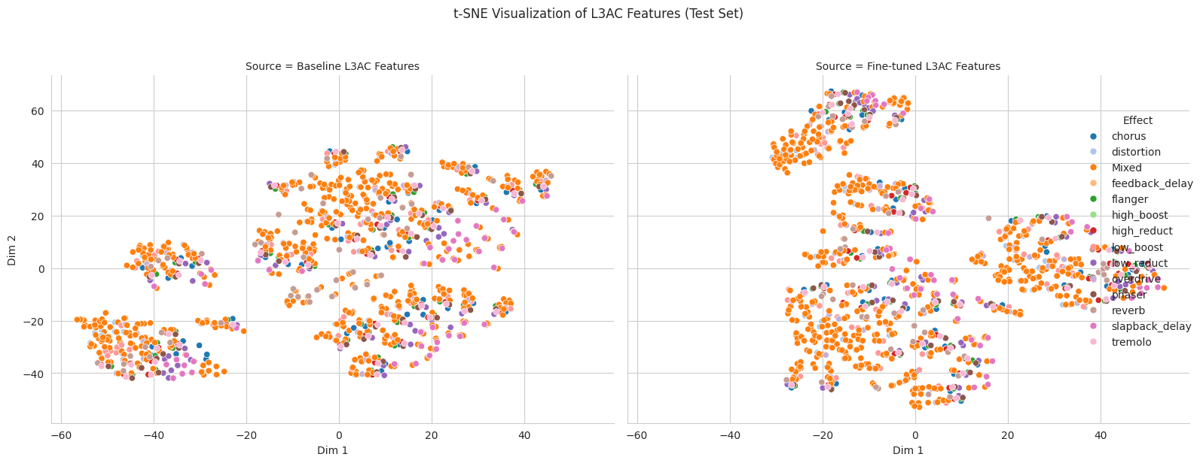
Feature Visualization

Slide 12
References
Colab Notebook
Comprehensive Drive
L3AC Paper
L3AC GitHub
L3AC Checkpoints and Pretrained Models
DAFx Paper
SFX Learner GitHub
GuitarSet GitHub

